Slide 1
Unit Two Values
Text B
The Richest Man in America, Down Home

Slide 2
Steve Jobs’ words:
1. Much of what I stumbled into by following my curiosity and intuition turned out to be priceless later on.
2. There's a phrase in Buddhism, 'Beginner's mind.' … Think of beginner's mind as the mind that faces life like a small child, full of curiosity and wonder and amazement.
初学者的心态。初学者的心态正如一个新生儿面对这个世界一样，永远充满好奇、求知欲、赞叹。

Slide 3
3. Your time is limited, so don't waste it living someone else's life. … Don't let the noise of other's opinions drown out your own inner voice. And most important, have the courage to follow your heart and intuition. … Everything else is secondary.
你的时间有限，所以不要为别人而活。…不要让别人的意见左右自己内心的声音。最重要的是，勇敢的去追随自己的心灵和直觉，… ，其他一切都是次要。

Slide 4
4. We're here to put a dent in the universe.
活着就是为了改变世界.
5. The only way to do great work is to love what you do.
6. Stay hungry; stay foolish.
求知若渴，大智若愚。

Slide 5
Warming-up discussion:
What values do you attach more importance to? Why?
(honesty, sincerity, loyalty, courage, perseverance, friendliness, kindness, generosity, integrity, selflessness, sympathy, charity (慈善), thriftiness, forgiveness, patience, cooperation, tolerance, justice, thoughtfulness, sharing, simplicity, diligence, independence/ self-reliance, hardworking, etc.)

Slide 6

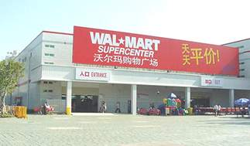
The Richest Man in America,
Down Home
Notes:
本张幻灯为课文讲解的开始，标题上有链接
The richest man in America上的链接灯片4，目的是让学生了解文章的背景
down home上链接幻灯5，6让学生在文章中寻找down home的同义词，理解这个词组是什么意思

Slide 7
The Richest Man in America, Down-home
Down-home: adj. 淳朴的，有乡土味的
Skim the passage and figure out:
1. Key words used to describe Sam Walton
2. The image the author wants to present
3. The image presented convincing or not? Why?
--- indirect description

Slide 8
Organization
Part 1: Para 1-4 past tense
Part 2: Para 5-13 present tense
Part 3: Para 14-22 present tense; But (Para 14)
Part One: The waiter was disappointed to find that the richest man in America led so simple a life.
Part Two: Being friendly, easy-going and never flashy, Walton carries on like plain folks and never wants any special treatment.
Part Three: With the Wal-Mart team in mind, Walton devotes himself heart and soul to making
the business a great success.

Slide 9
main ideas?
Despite his wealth, Sam Walton remains down-home and devoted to his team.

Slide 10
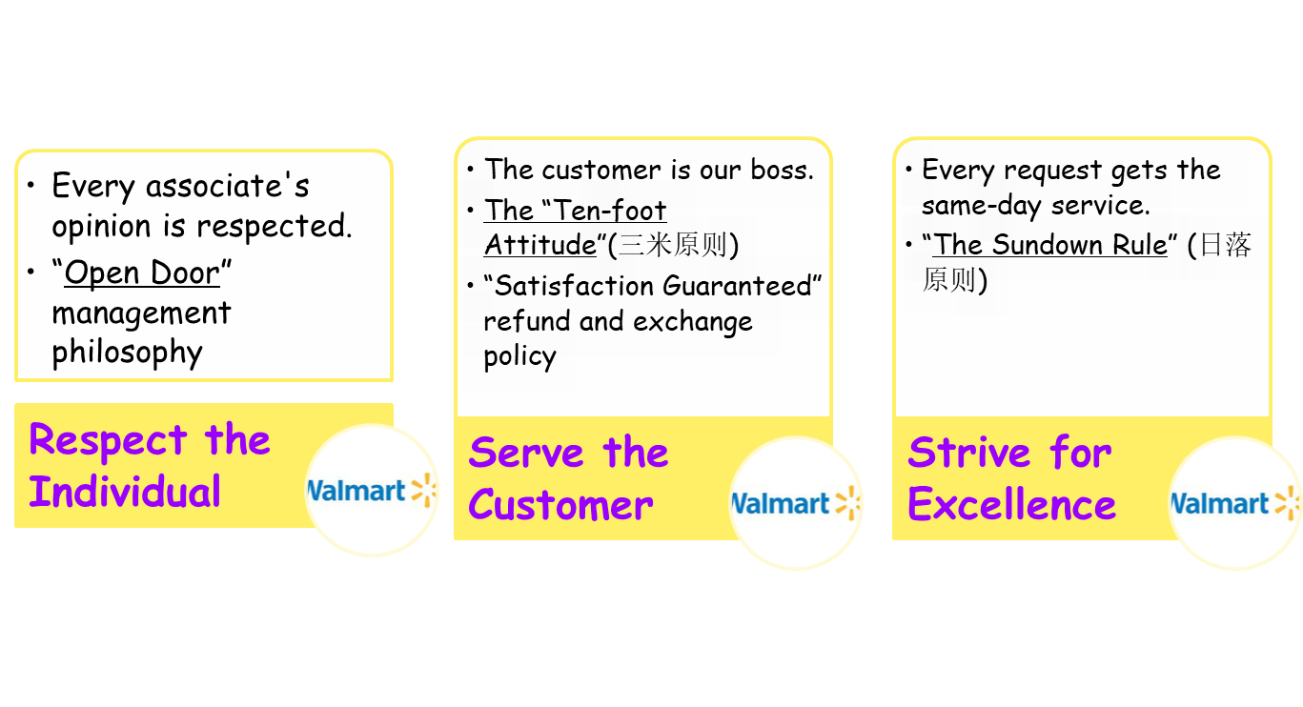
The Wal-Mart culture --– the three basic beliefs

Slide 11
Values held dear by Sam:
The Wal-Mart Way of Life:
( Para 17 )
The rules of working established by Sam Walton: “Ten Rules For Success” to guide the operation of the company.
① Commit to your business.
② Share your profits with all your associates and treat them as partners.
③ Motivate your partners.
④ Communicate everything you possibly can to your partners.

Slide 12
⑤ Appreciate everything your associates do for the business.
⑥ Celebrate your success and find humor in your failures.
⑦ Listen to everyone in your company and figure out ways to get them talking.
⑧ Exceed your customer’s expectations.
⑨ Control your expenses better than your competition (竞争对手).
⑩ Swim upstream – go the other way – avoid conventional wisdom.
(The Wal-Mart Way)

Slide 13
Reading skill: guessing the meaning
Figure out the meaning of the underlined parts:
1. Only in America can a billionaire carry on like plain folks and get away with it.
2. Sam Walton, though the richest, still waits in line like everyone else to buy shells at the local Wal-Mart when shooting season comes.
3. “He is just not a front-page person,” a newspaper employee explains. But one morning, this richest man in America did something that would have made headlines in any newspapers in the world.
(make/ hit/ grab <the> headlines:)

Slide 14
4. But his stores are always on his mind. One tennis guest managed to put him off his game by asking why balls cost more in one Wal-Mart than another. It worked and Sam lost 4 games.
5. Ferold, who was stunned (extremely surprised or impressed) at Sam’s generosity after the stingy employer he left to join Wal-Mart, said: “I had to change my way of thinking when I came aboard (Wal-Mart).”
6. I’ve never seen anyone yet who worked for him or who was around him for any length of time who was not better off. I don’t mean just financially.

Slide 15
Names in the Text
Sam Walton
Jamie Beaulieu
Jim Hendren
Gordon Garlington III
Johnny Baker
Jim Von Gremp
Ferold F. Arend
John Mayhall
owner of Wal-Mart
company lawyer
the barber
retired president
waiter
corporate affairs director
night manager
pastor of local church
Notes:
本张灯片训练学生查读能力，同时让他们熟悉各种职业的名称

Slide 16
Background Information
1. Sam Walton & Wal-Mart:
In 1962, a forty-four year old man named Sam Moore Walton opened his first Wal-Mart store in Arkansas. He previously owned a small variety store called Five & Dime (廉价品店), but he had his mind set on much bigger ideas. Walton had gained an understanding of providing top customer service and hoped that a discount store offering a variety of products would attract large numbers of customers.

Slide 17
He was right. Sam Walton quickly became a multi-million dollar success story, more successful than he could have ever dreamed. Wal-Mart ranked No. 1 of the FORTUNE 500. Walton’s three basic beliefs were respecting every individual, providing top notch (等级档次) customer service, and striving for excellence (The Wal-Mart Way). He wanted to have the best retail store (零售店) with the best customer service, the best employees and the best prices.

Slide 18
Language Study
Part One (1 – 4 ) :
The waiter was disappointed to find that the richest man in America led so simple a life.

Slide 19
wheel (Para 2) : = drive
⑴ carry someone or something in or on an object that has wheels
eg. Mary wheeled a load of newspapers in her wagon to the newsstands nearby. 玛丽把一大摞报纸用小车送往附近的报摊
⑵ push something that has wheels
eg. The nurse wheeled the patient who has just been operated in to the ward.
护士把刚动完手术的病人推进病房

Slide 20
discount: n. amount of money which is taken away from the full price of sth.
eg. We give (a) 10% discount (10% off) for cash.现金付款，我们予以九折优待。
Many stores offer discounts on holidays.
v. Eg. discounted prices
discount shop/store = discounter: shop which regularly sells goods at less than the usual price 折扣店

Slide 21
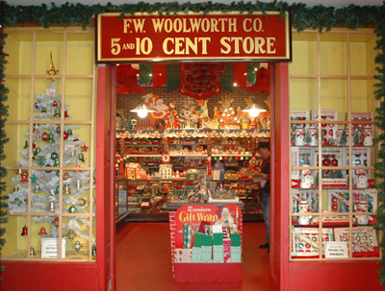
dime store
It’s a store offering a wide assortment of inexpensive items, formerly costing five or ten cents, for personal and household use.
(nickel: 5分镍币)

Slide 22
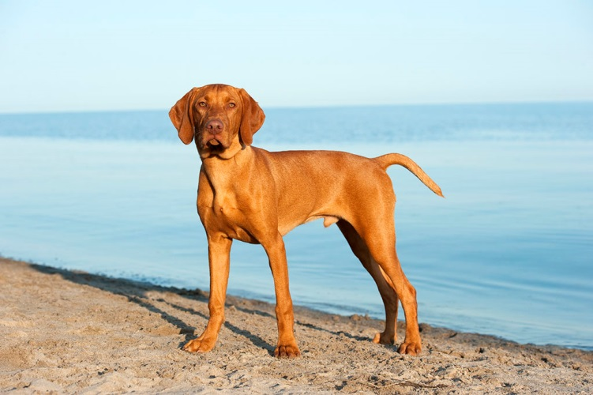
muddy bird dog
土褐色的捕禽猎犬

Slide 23
Part Two (Para 5-13):
Being friendly, easy-going and never flashy, Walton carries on like plain folks and never wants any special treatment.

Slide 24
Only in America can a billionaire carry on like plain folks and get away with it. (Para 5)
Paraphrase: It is only in America that a billionaire can live in the same way as ordinary people and keep doing this (without being bothered by the public).
只有在美国，亿万富翁才能象普通百姓一样，安稳地过着普普通通的生活。

Slide 25
only + 状语--- 置于句首: 倒装 in writing and formal speech
eg. Only then did peter realize that he still hadn’t phoned his mother.
only,否定副词等出现在句子开头, 如never, no, hardly, little, 或形容词、副词放在句首起强调作用，那么句子要倒装。
eg.1. Only when you are present can we continue with our plan.
2. Never before have I experienced such an exciting moment.
3. So exhausted was he that he did not want to say a word after he got home.

Slide 26
carry on (Para 5)
behave in a specific way以某种方式行事
There’s nothing unusual about them. They carry on just like everybody else.
He carries on as if he were a millionaire, spending money left, right and center. 到处
carry on (doing sth/ <with> sth); carry sth on:
continue, esp. in spite of difficulties or an
interruption 继续做，坚持干
eg. Carry on (working/with your work) while I’m away.
Carry on the good work. 干得不错，继续努力。
We’ll carry on our conversation/ discussion
tomorrow.

Slide 27
Carry sth out: fulfill or complete 贯彻，执行，实施，完成
Eg. carry out a plan/ a duty/ an order

Slide 28
get away with sth:（infml）
If you get away with doing sth. wrong or risky, you don’t suffer any punishment or other bad consequences because of it.
eg. 1. If you cheat in the exam you’ll never get away with it. 考试作弊必予追究
2. Nobody gets away with insulting me like that. 这样侮辱我的人，我是不会
放过的。

Slide 29
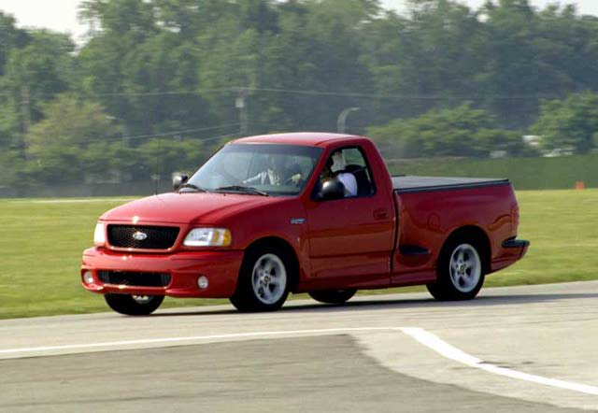
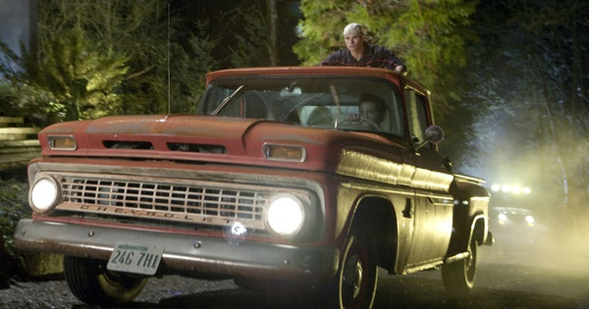
pickup (truck) 皮卡货车，敞篷小货车(Para 3+5)

Slide 30
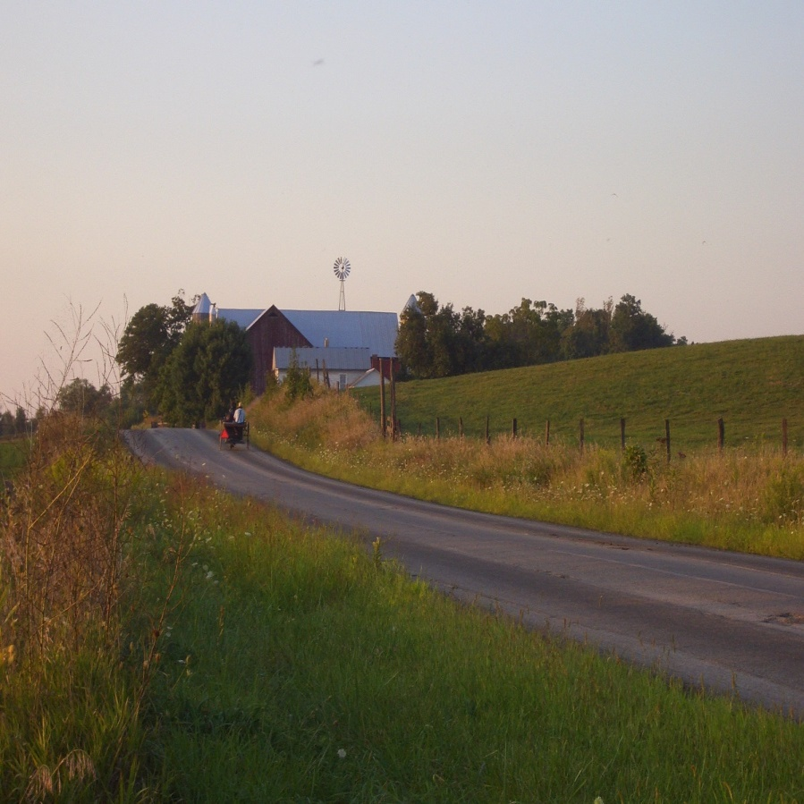
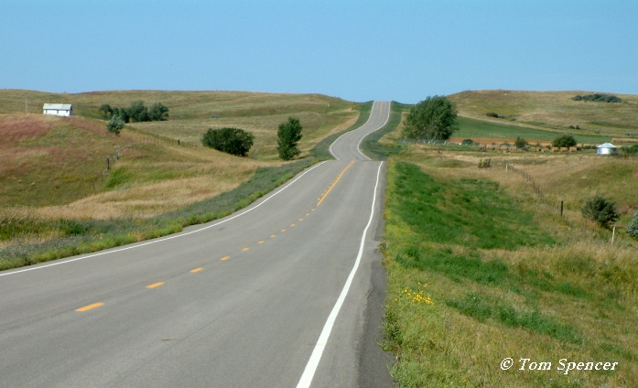
back roads 乡间小道

Slide 31

Hunting/ shooting season (Para 5)
a traditional sport
The shooting periods are strictly regulated by law, normally between September and April next year, vary in different states.
Pigeon, deer, turkey…

Slide 32
Para 7: By all accounts, he’s friendly, cheerful, a fine neighbor who does his best to blend in, never flashy, never throwing his weight around.
人人说他为人和善，性情开朗，是个好邻居；他尽力于人们融洽相处，从不炫耀，也从不盛气凌人。

Slide 33
by/from all accounts: according to all that has been said or reported 人人都说，据说
eg. It will be a match worth watching, by all accounts.
所有人都说这场比赛值得一看
by one’s own account：according to what one says oneself 据某人自己所说

Slide 34
blend in (Para 7): if sb. blends into a particular group or situation, or if they blend in, they seem to belong there or are not noticeable, because their behavior is similar to that of the other people involved. 协调，融合；打成一片
blend into sth; blend in with sth
eg. 1. As a newly-appointed manager, he was not sure whether he could blend in.
2. The new office building doesn’t seem to blend in with its surroundings.
新的办公大楼似乎与周围环境不协调

Slide 35
throw one’s weight around/about: (infml) behave in an aggressively arrogant way 盛气凌人 逞威风
eg. 1. Mr. Smith is not much of a manager. He always throws his weight around.
2. I’m not going to have him throw his weight about with me.
我可不会让他对我指手画脚.

Slide 36
He chats about the national news, or reads in his chair, perhaps the Benton County Daily Democrat, another Walton property that keeps him off the front page. (Para 10)
… 从不在头版刊登有关他的消息。

Slide 37
keep him off the front page: have Walton’s information or news not shown on the first page;
keep him on the front page: have Walton’s information or news printed on the first page

Slide 38
… that would have made headlines anywhere in the world (Para 12)
make/ grab/ hit headlines: become important news 成为重要/头条新闻

Slide 39
Part Three (14 – 22) focus for Part Three?
With the Wal-Mart team in mind, Walton devotes himself heart and soul to making the business a great success.

Slide 40
But just how long Walton can hold firm to his folksy habits with celebrity hunters keeping following wherever he goes is anyone’s guess. (Para 14)
然而，沃尔顿所到之处都有追星族紧追不舍，他的平民习惯能保持多久，就很难说了。

Slide 41
Part Three (14 – 22) focus for Part Three?
But just how long Walton can hold firm to his folksy habits with celebrity hunters keeping following wherever he goes is anyone’s guess. (Para 14)
Paraphrase: Many people are curious to know, with so many celebrity hunters following Walton wherever he goes, how long Walton can remain floksy and friendly.
然而，沃尔顿所到之处都有追星族紧追不舍，他的平民习惯能保持多久，就很难说了。

Slide 42
hold firm/ fast to sth: (keep to sth, stick to sth) follow exactly; keep to something such as a promise, a belief, a principle, one’s word, a point of view etc. 坚守（信仰，诺言等）
eg. 1. I shall hold firm to my decision. 我将坚持我的决定。
2. He holds firm to his belief that honesty is the best policy.
celebrity hunters: the group of people esp. reporters who like to follow famous people for news or information 狗仔队

Slide 43
anybody’s/ anyone’s guess: (infml.)
sth that nobody can be sure about 谁也拿/说不准
Eg. What will await me on my way to the remote town is anybody’s guess.
译：我的未来会是个什么样子谁也说不准。
What the future holds for me is anyone’s guess.
What my future will be like is anyone’s guess.

Slide 44
on the run (Para 14) : 1. trying to avoid being captured; fleeing from pursuit or capture 奔逃，逃避
eg. He’s on the run from the police.躲避警方的追捕。
have/keep the enemy on the run 逼得敌人奔窜
2. continuously active and moving around
Eg. I’ve been on the run all day and I’m exhausted. 我整天忙个不停，疲于奔命。

Slide 45
steer/keep/stay clear of sb./sth (Para 14)：
keep away from sb/sth 避免/开
eg. 1. I prefer to keep clear of town during the rush-hour.
2. His doctor advised him to steer clear of alcohol.

Slide 46
be liable to do: (Para 16)
1. be likely to do 可能做…
eg. We’re all liable to make mistakes when we’re tired.
人若疲劳谁都可能出差错。
2. be liable to do sth:
to/ for sth: have to do sth by law 负有… （法律）责任
Eg. People who earn above ￥3000 a month are liable to (pay) tax/ for tax.
liability: n. （法律上对某事的）责任，义务

Slide 47
Para 17:
… It’s all part of the Wal-Mart way of life as laid down by Sam: loyalty, hard work, long hours; get ideas into the system from the bottom up, Japanese-style; treat people right; cut prices and margins to the bone and sleep well at night ….

Slide 48
lay down (Para 17) : officially establish a rule, or officially state the way in which sth. must be done 制定；规定
eg. 1. Conditions for membership are laid down in the soccer club rules.
2. It is laid down that all applicants must sit (for) a written exam.
根据规定，申请者一律须经笔试 .

Slide 49
cut prices and margins to the bone: (Para 17) reduce prices and margins considerably or dramatically or as much as possible 尽可能降低价格，减少利润 (= profit margin)
cut sth. to the bone: reduce sth. considerably or as much as you can大幅度减少,尽量削减
eg. The factory has survived __________ (通过节俭开支).
by cutting its cost to the bone.

Slide 50
qualify: (Para 17)使合格；使具有资格； 有权利
qualify (sb) for sth/ to do sth/as sth
eg.1. He is qualified for this post.
2. The training program qualifies him as a referee. 培训项目让他取得了裁判员资格。
3. He is the manager’s son, but that does not qualify him to criticize my work.
(Just because ……)
4. They failed to qualify for the World Cup.未能打进世界杯。
qualification n. 资格
eg. Patience is an essential qualification
for this job.

Slide 51
option: (Para 17)
1. the right to buy or sell sth at some time in the future (未来)购买或出售权，期权
eg. He has taken an option on that house/ to buy that house. 有权购买那所房子
share/ stock options: the right to buy shares in a company (usu. considered a privilege) 认股选择权
2. the right or freedom to choose what you want 选择，选择权
Eg. You have no option/ choice/ alternative but to face it.
There are three options open to us in that matter.
在这个问题上我们有三个选择的可能。

Slide 52
3. a subject that a student can choose to study without having to
选修课
4. (computing) one of the choices you can make when using a computer program
Eg. Choose the “Paste” option from the Edit menu. 从编辑菜单里选择“粘贴”项。

Slide 53
put sb off (sth): (Para 18) prevent sb from concentrating on sth.; distract sb 使某人分心
eg. 1. She said it would put her off if I laughed.
2. The sudden noise put her off her game.
突如其来的嘈杂声分散了她比赛时的注意力.

Slide 54
Para 19:
Walton set up a college scholarship fund for employees’ children, a disaster relief fund to rebuild employee homes damaged by fires, floods, tornadoes, and the like. He believed in cultivating ideas and rewarding success.
Q. What kind of person is Sam? Values?

Slide 55
… and the like(Para 19) : and other things of the same sort
eg. Always carry your ID card, money and the like with you while traveling.

Slide 56
He believed in cultivating ideas and rewarding success. (Para 19)
他信奉广开思路，褒奖成功。
reward: n.报酬, 奖金
vt.酬劳, 奖赏( ~ sb for sth with sth)
eg. She rewarded the boy with＄10 for his help.
她因那男孩帮助而酬谢他十美元。
Cf: award n.奖, 奖品 vt.授予, 颁奖

Slide 57
Reward: n. v. give sth to sb because they have done sth good, worked hard etc. (给)报酬, 奖励, 奖赏
Reward sb with sth for (doing) sth: 用… 报酬某人某事
Eg. Our hard work/ patience was finally rewarded.
He rewarded us with $100 for helping him find his lost dog.
Rewarding: adj. worth doing值得做的, 有益的 eg. rewarding job/ experience
Unrewarding:未能给人以成就感的

Slide 58
Award: n.; vt. officially give sb sth as a prize etc. 颁奖, 授予奖励/ 学位等
award sb sth
award sth to sb
Eg. Award sb a prize
an honorary degree
a scholarship
a title
etc.

Slide 59
come/ get aboard: (Para 20) (AmE, infml) join 入伙，加盟
eg. This is her second promotion since coming aboard.
aboard: adv./ prep.
eg. Welcome aboard (the ship/ the company/ the club)!

Slide 60
I’ve never seen anyone yet who worked for him or was around him for any length of time who wasn’t better off. And I don’t mean just financially… --- coming into contact with Sam Walton just makes you a better person. (Para 22)
我从没见过有谁为他工作或和他接触一段时间后而不受益的。我不仅仅指钱财方面…。我是说他内在的某种东西---与他交往会使你成为一个更完善的人

Slide 61
be better off: having more money 比较宽裕/富裕
be better off (doing sth)/ (without sb/sth): be happier or more at ease if doing sth or if without sb or sth
（在某种情况下）更幸福/满意
eg. We’d be better off without them as neighbors. 要是没有这家邻居，我们就过得更愉快了。

Slide 62
Key to Ex. Text B
Comprehension check: 1-6:B B D D D D
Translation:
1. 只有在美国，一个亿万富翁才能像普通百姓一样生活，而不受干扰。
2. 人人都说他为人友善，性情开朗，是个好邻居；他尽力与人们融洽相处，从不炫耀，也不盛气凌人。
3. 但最近有天早上，美国首富做了件在任何其它地方准会成为头条新闻的事：他忘了带钱。
4. 然而， 沃尔顿所到之处名人追星族紧跟不舍。他的平民习惯能保持多久，就很难说了。
5. 一位来打网球的客人为了分散他打网球的注意力，故意问了句为什么一筒网球在一家沃尔玛店卖得比另一家沃尔玛店贵。此话并非实情，但这一招确实管用。沃
尔顿连输四局。

Slide 63
Language Practice:
1. f – 1); c – 2); g – 3); e – 4);
b – 5); a – 6); h – 7); d – 8)
2. 1) stunned 2) hold (fast/ firm) to
3) folks 4) generosity
5) discount 6) liable
7) ranks 8) on the run
9) make up 10) blends in
11) by all accounts
12) comes into contact with

Slide 64
Homework:
1.Prepare for the Oral Test.
2. Prepare for the Final.
3. Go on to rehearse short plays. (Jan. 5, 2017)
Happy New Year!!!

Slide 65
Paragraph Translation：Translate with the newly-learned expressions.
自从他加盟以来，乔治从早忙到晚。他总是乐呵呵的，一直全身心扑在工作上。由于表现出色，几个月前，他被提升为执行总裁。从那以后，他尽力和工人打成一片，从不盛气凌人。另外，他制定了一些奖励制度，鼓励工人们努力工作。他相信忠诚和勤劳会大大促使公司获得成功。人们都说他是位出色的执行总裁。
.

Slide 66
Key to Translation:
George has been on the run since he came aboard. He is always cheerful and devoted to his work heart and soul. Because of his excellent performance, he was promoted to CEO a couple of months ago. From then on, he has been trying hard to blend in with the workers and never thrown his weight around/ about. He also laid down/ introduced a reward system to encourage the workers to work hard, believing that loyalty and hard work will greatly contribute to the success of the company. By/ From all accounts, he
is an outstanding CEO
(chief executive officer).

Slide 67
Homework:
1. Review Text B, Unit 2 + finish the following exercises.
. 2. Finish reading Text A, Texts 1+2, U2, B2.
3. Go on to rehearse short plays.
4. Prepare for the Oral Test + the Final.

